Slide 1


Institute for Advanced Computing and Software Development DDoS Detection and analysis
Guided by - Akshay Tilekar Project by - 210541283026 ( Mahadevi Bandapalle)
- 210541283030 ( Snehal Mane)
-

Slide 2
Contents:
Introduction
Objectives
Methodology
Technology
Advantages
Application
Conclusion
References

Slide 3
Introduction:
DDoS attack is an intentional attack type which is usually made in a distributed computing environment by targeting a website or a server so as to minimize their normal performance.
To achieve this, an attacker uses multiple systems in a network. Now, using these systems, the attacker makes an attack on the target website or server by making multiple requests to the target system or server.
As these types of attacks are carried out in distributed environments, hence, these are also called distributed DDoS attacks.

Slide 4
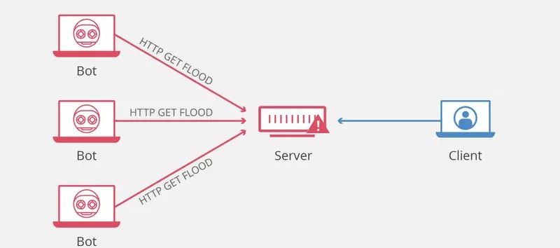
What is DDoS:
Denial of Service Attack: an attack on a computer or network that prevents legitimate use of its resources.
DoS Attacks Affect:
Software Systems
Network Routers/Equipment/Servers
Servers and End-User PCs

Slide 5
Objectives:
DDoS detection is the process of distinguishing distributed denial of service (DDoS) attacks from normal network traffic in order to perform effective attack mitigation.
The primary goal of a DDoS attack is to either limit access to an application or network service, thereby denying legitimate users access to the services.

Slide 6
Technology used:
Python
ML Classification algorithms

Slide 7
Methodology:
Importing libraries.
Data preprocessing.
Extracting features.
Train test splitting.
Applying classification models.
Prediction for test data.

Slide 8
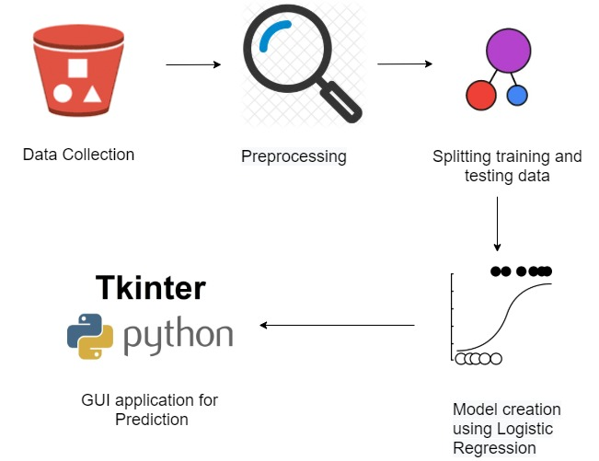
Ml flow:

Slide 9
Advantages:
prevents malicious traffic from reaching its target.
limiting the impact of the attack.

Slide 10
Future scope:
As the data is being analyzed the prediction of a recorded system been attacked gets furthermore accurate.
And also we can predict which system should be blacklisted on the basis of attacks it has performed.

Slide 11
Conclusion:
Denial of Service is currently the most expensive computer crime for victim organizations.
Strategic firewall placement allows companies to use the Internet during a DDoS attack, and it allows them to continue receiving the packets they want.
Distributed Denial of Service Attacks could be Detected by Monitoring the Source IP.
It is easy to generate a successful DDoS attack that bypasses these defenses

Slide 12
References:
https://www.comptia.org/content/guides/what-is-a-ddos-attack-how-it-works
http://www.usenix.org/events/lisa2000/full_papers/dietrich/dietrich_html/
https://ieeexplore.ieee.org/document/5401280
https://www.hindawi.com/journals/scn/2018/9804061/

Slide 13
THANK YOU !

